Slide 1

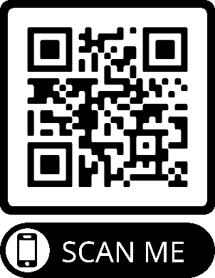
MORE RESOURCES
Social and Education Information for Youth
who are Not Documented
Young people who are not documented are sometimes called Dreamers. They often face a lot of stress for many reasons. One reason is worry about their chance to study beyond high school. One other reason is fear that they or a loved one could be deported. There are programs that offer information about resources. They can help people understand that others have faced these barriers and that there are ways to address them. There are also national groups that can provide helpful guidance about education opportunities:
National Resources
United We Dream
https://unitedwedream.org/resources/
Scholarships A – Z
www.scholarshipsaz.org
Immigrants Rising
https://immigrantsrising.org/
TheDreamUS www.thedream.us
US Department of Education, Supporting Undocumented Youth www2.ed.gov/about/overview/focus/supporting-undocumented-youth.pdf
Local Youth or Educational Resources
[Doctor or clinic staff: write in any local resources such as youth support groups or educational resources available locally to counsel young people who are not documented. Or Google: educational resources immigrant students, name of your area]
_____________________________________
_____________________________________
_____________________________________
_____________________________________
Immigration Status
and Your Health
Immigration problems can impact your health or the health of a family member or neighbor. Your doctor can help. This doctor’s office is a safe place to talk about your concerns and find resources.

Slide 2
RESOURCES:
Legal
We suggest that you find and attend a “Know Your Rights” training that is offered by a qualified legal services group. If you cannot find a training nearby, you can look online for know your rights resources. Be sure that your family knows what to do if ICE agents come to your door. Be sure to make a safety plan about what to do if you are detained and you have children who need to be cared for.
ACLU
www.aclu.org/know-your-rights
National Immigrant Justice Center (NIJC) https://immigrantjustice.org/know-your-rights/ice-encounter
Local Legal Resources
AILA Find an Immigration Lawyer https://ailalawyer.com
[Doctor or clinic staff: write in advance any local resources such as an immigration law clinic at your local university or any community organizations that can provide referrals to legal services. Then, delete this text.]
____________________________________________________________
____________________________________________________________
HIGH PRIORITY! Updating Emergency Contacts
If you are a parent, you want to be sure that your children will be picked up from school by the family members or persons you wish should you be detained.
Important: Be sure that the Emergency Contact information at your child’s school is up to date with the name and phone number of the persons you choose. This will be the person the school calls if you do not show up to pick up your children and cannot be reached. You can usually update the contacts online at the webpage of your child’s school or school district. It can also usually be done in person at the school’s administrative office. You should be sure to update this information immediately!
DEVELOPING AN EMERGENCY PLAN
The websites below will help you to make a more detailed plan in the event of being detained unexpectedly. There are many other good sites on the internet as well.
American Federation of Teachers (AFT), Creating a Family Immigration Raid Emergency Plan (En Inglés y Español) https://www.aft.org/sites/default/files/im_emergplan_020817.pdf
Immigrant Legal Resource Center, Family Preparedness Plan https://www.ilrc.org/sites/default/files/resources/family_preparedness_plan.pdf (Inglés) https://www.ilrc.org/sites/default/files/resources/plan_de_preparacion_familiar.v3.pdf (Español)
MORE RESOURCES: Social and Educational Information for Youth that are Not Documented, on next page.

